Slide 1

Report for BFX-AT100 - Mar 2023 Mass Production Inspection
FOXCONN CPEG JBD_VN
Apr 03, 2023

Slide 2
Establish the Team
Team Leader
Team Member
PE: Michael, Nam
ME: Cheng Lun, Hugo
PM: An Tran, Yuri
PD: Wen Yong
QA: Ken, Robert
TE: Mark, Jones
IE: Hai Ly, Heng Ruan
Foxconn
  MFG Manager : David Yin
  QA Manager : Toney Tu/ CB Lin

Slide 3
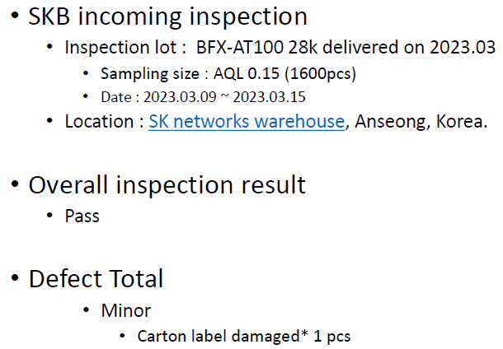
Description of Problems
Issue Description
On Mar 27, 2023 ALT customer feedback about Mass Production Inspection for shipment lot in Feb-2023 Detail as below:

Slide 4
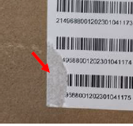
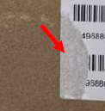
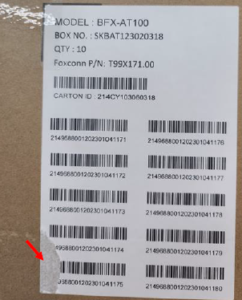
Failure Analysis Report
1. Carton label damaged
Issue Description | Root cause | Actions | Status
Symptom: Carton Label damaged – can’t read barcode. Defect Q’ty : 1/160 carton box Carton No : 214CY103060318 | Fii checks line production process. At Pack carton station, Operator must check carton label before pastes on carton box, and he wasn’t found abnormal . At Kitting, Operator must scan all carton labels to print out pallet label, If label was damaged he will be re-print one new label. Occur root cause: As NG picture, there are some damaged areas near the damage label location. Therefore, maybe occur in transfer, load or unload process, something was stuck on the box carton and label and someone was removed it lead to damage label. Escape root cause: The person who removed the stuck object didn’t confirm this issue to print label again. CQA and operator at stock did not detect this issue when checking pallet before shipment lead to escape. | Fii action: Remind operator in stock, when detecting any objects stuck on carton, must be inform with leader first (Done). And when removing any objects stuck on carton must be check again, if the carton box or label was damaged, must be replace by new one (Done). Add NG picture in SOP and re-train CQA and operator in stock must check carefully carton label before shipment (Done). | Monitor
NG

